Slide 1

Nudos para guías de rafting
La practica lo hace permanente

Slide 2

Nudos basicos para guias de rio
Los nudos se crean cuando una cuerda se ata a sí misma.
Los tirones se crean cuando una cuerda se ata alrededor de algo.
Los dobleces se crean cuando se unen 2 cuerdas.
Notes:
1,Knots are created when a rope is tied onto its self eg Fig8 Bite, Fig 8 rethread, Alpine butterfly
2, Hitches are created a rope is tied around something eg Clove hitch, Italian hitch, Round turn & Two half hitches
3, Bends are created when 2 ropes are joined together. Eg Overhand, Double fishermans, Figure 8

Slide 3
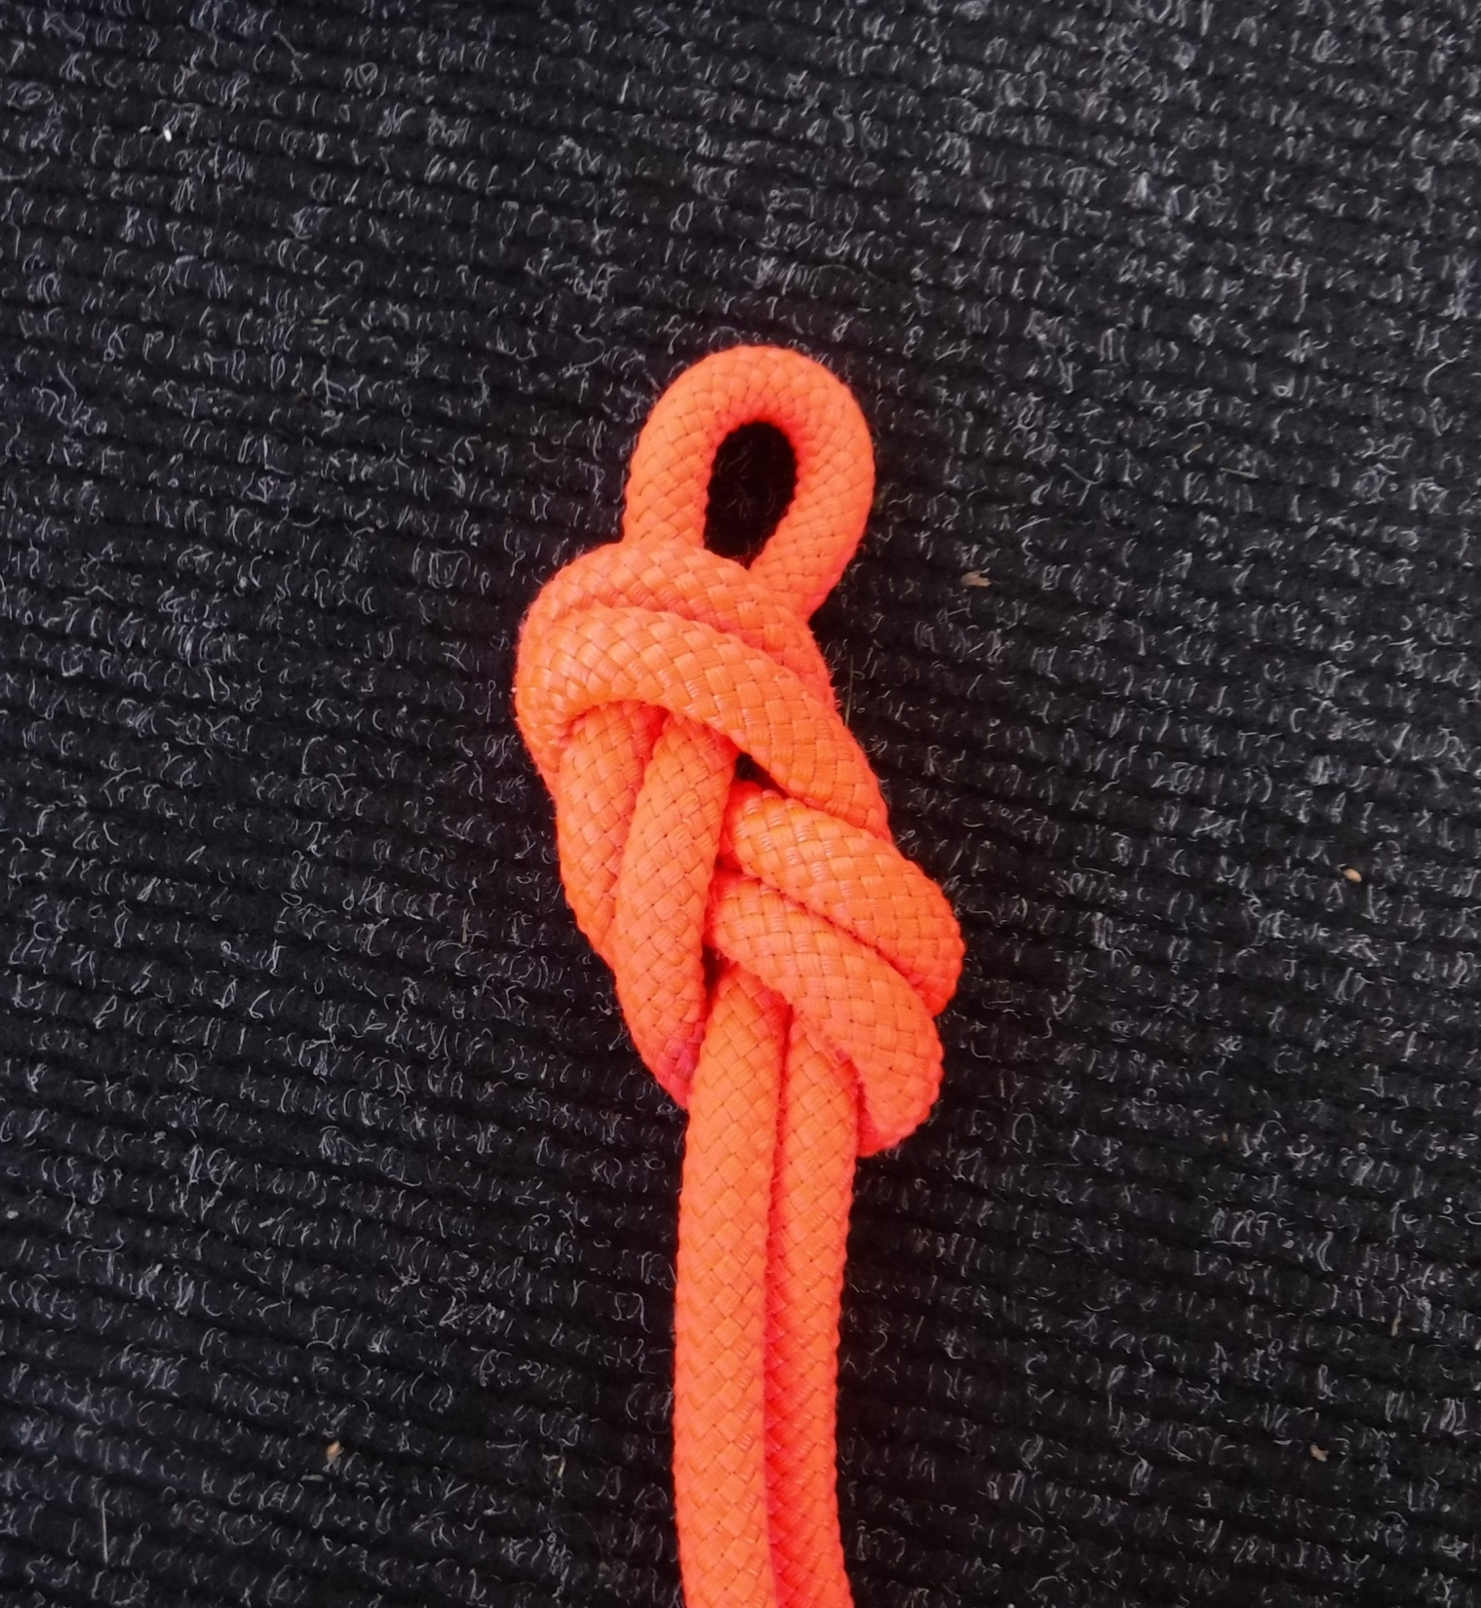
Figura 8
Crea un bucle en el extremo de una cuerda
Debe vestirse de forma plana.
Los 2 cordones exteriores deben apretar el nudo.
El circuito debe ser pequeño cuando se usa en un entorno de aguas bravas
Notes:
1,Knots are created when a rope is tied onto its self eg Fig8 Bite, Fig 8 rethread, Alpine butterfly
2, Hitches are created a rope is tied around something eg Clove hitch, Italian hitch, Round turn & Two half hitches
3, Bends are created when 2 ropes are joined together. Eg Overhand, Double fishermans, Figure 8

Slide 4
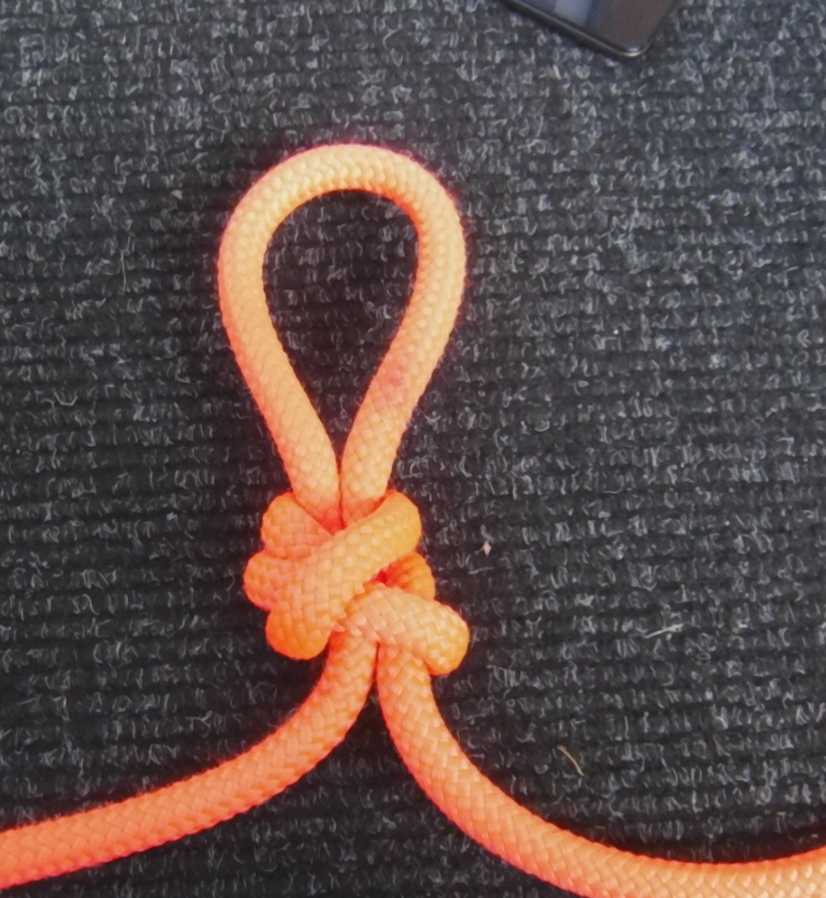
Mariposa
Crea un bucle en cualquier parte de la cuerda.
Multi direccional.
Normalmente se utiliza en la creación de un ancla para tirar de la barca
Notes:
1,Knots are created when a rope is tied onto its self eg Fig8 Bite, Fig 8 rethread, Alpine butterfly
2, Hitches are created a rope is tied around something eg Clove hitch, Italian hitch, Round turn & Two half hitches
3, Bends are created when 2 ropes are joined together. Eg Overhand, Double fishermans, Figure 8

Slide 5
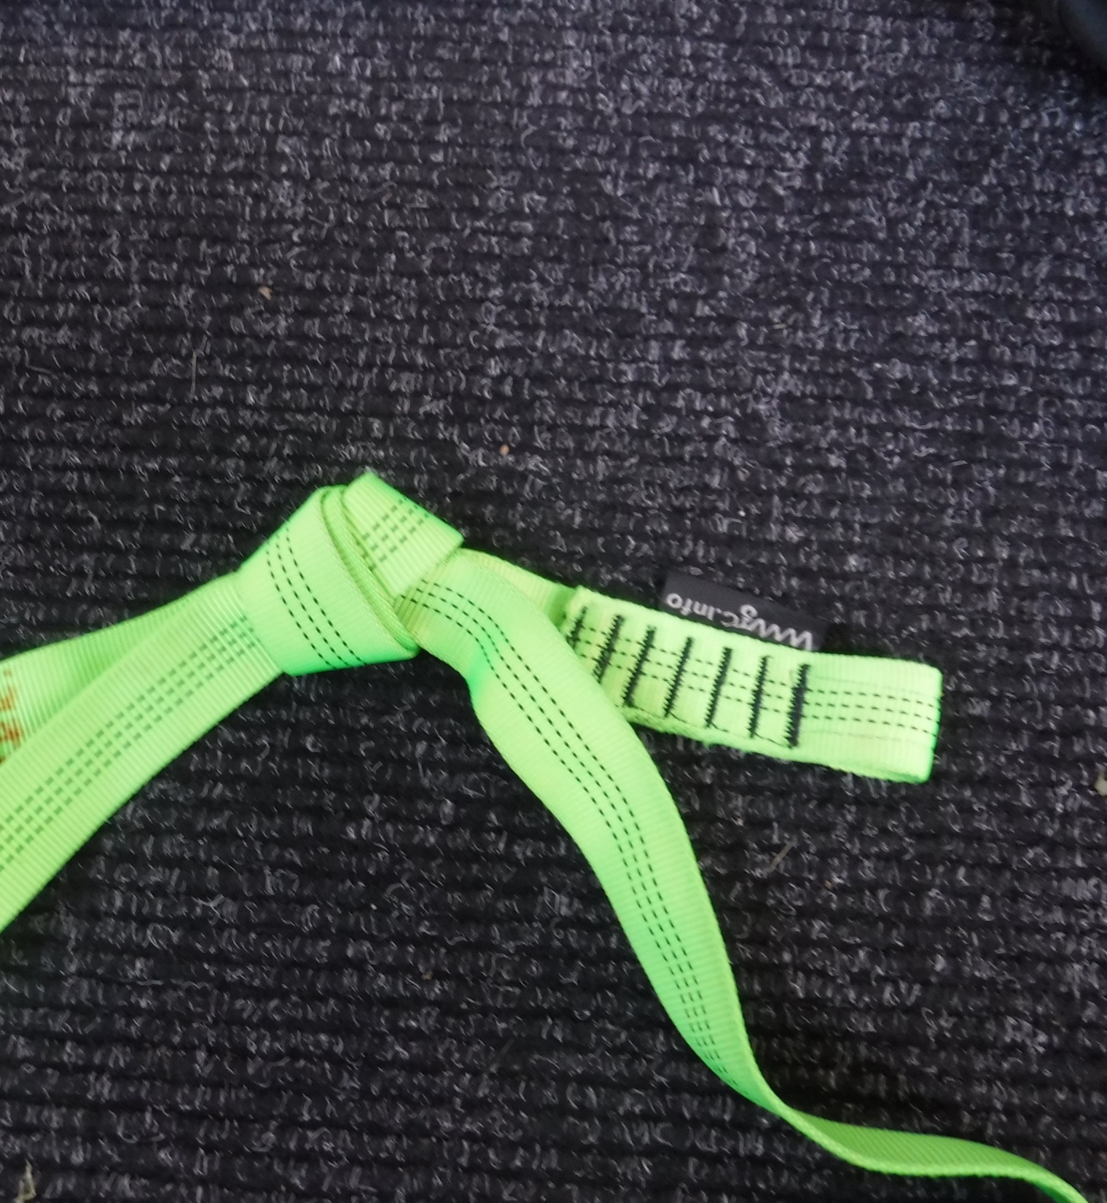
Nudo cinta
Usado para unir 2 pedazos de cinta.
Asegúrate de que la cola tenga más de 1 ancho de manos
Viste el nudo correctamente, debe estar plano
Notes:
1,Knots are created when a rope is tied onto its self eg Fig8 Bite, Fig 8 rethread, Alpine butterfly
2, Hitches are created a rope is tied around something eg Clove hitch, Italian hitch, Round turn & Two half hitches
3, Bends are created when 2 ropes are joined together. Eg Overhand, Double fishermans, Figure 8

Slide 6
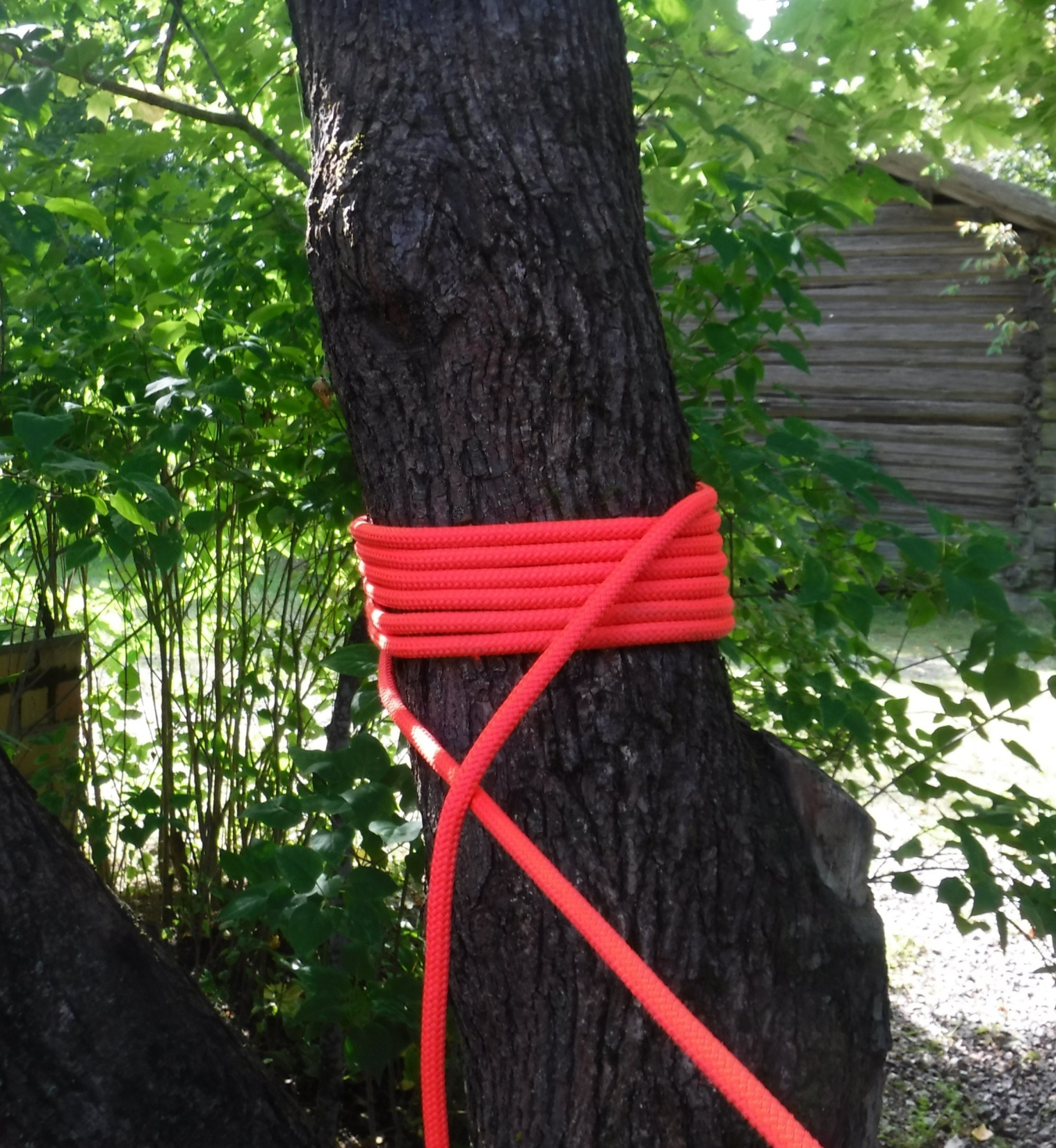
No nudo
Se usa para asegurar una carga crítica, p. Ej. Personas.
Retiene una gran cantidad de la fuerza de las cuerdas.
Liberable bajo tensión / carga.
El objeto al que está atando debe ser más que el diámetro de las cuerdas.
Notes:
1,Knots are created when a rope is tied onto its self eg Fig8 Bite, Fig 8 rethread, Alpine butterfly
2, Hitches are created a rope is tied around something eg Clove hitch, Italian hitch, Round turn & Two half hitches
3, Bends are created when 2 ropes are joined together. Eg Overhand, Double fishermans, Figure 8

Slide 7
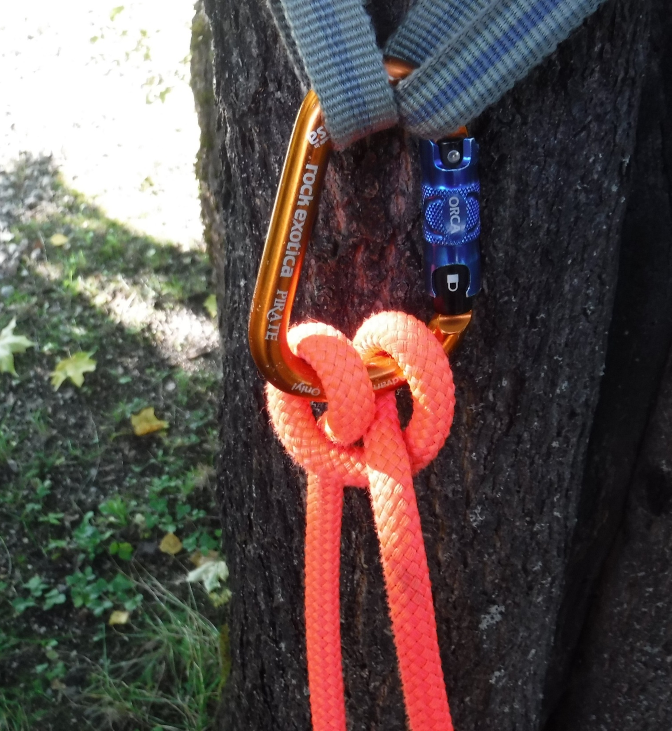
Ballestrinque
Un enganche ajustable que se puede atar de varias maneras rápidamente.
Siempre debe estar atada ya que se puede unir y deslizar. (se debe hacer un nudo redundante)
Notes:
1,Knots are created when a rope is tied onto its self eg Fig8 Bite, Fig 8 rethread, Alpine butterfly
2, Hitches are created a rope is tied around something eg Clove hitch, Italian hitch, Round turn & Two half hitches
3, Bends are created when 2 ropes are joined together. Eg Overhand, Double fishermans, Figure 8

Slide 8
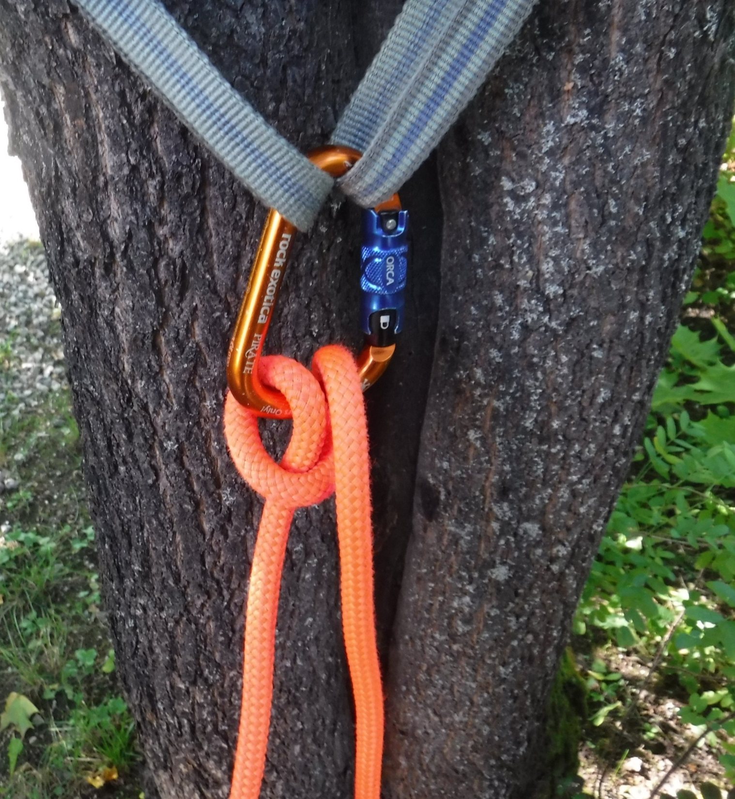
Dinamico
Un enganche popular utilizado para aseguramiento o cargas bajas.
Utiliza un equipo mínimo
Puede introducir dobleces y giro a la cuerda.
Use protección para las manos cuando trabaje con cargas de más de 100 kg.
Notes:
1,Knots are created when a rope is tied onto its self eg Fig8 Bite, Fig 8 rethread, Alpine butterfly
2, Hitches are created a rope is tied around something eg Clove hitch, Italian hitch, Round turn & Two half hitches
3, Bends are created when 2 ropes are joined together. Eg Overhand, Double fishermans, Figure 8

Slide 9
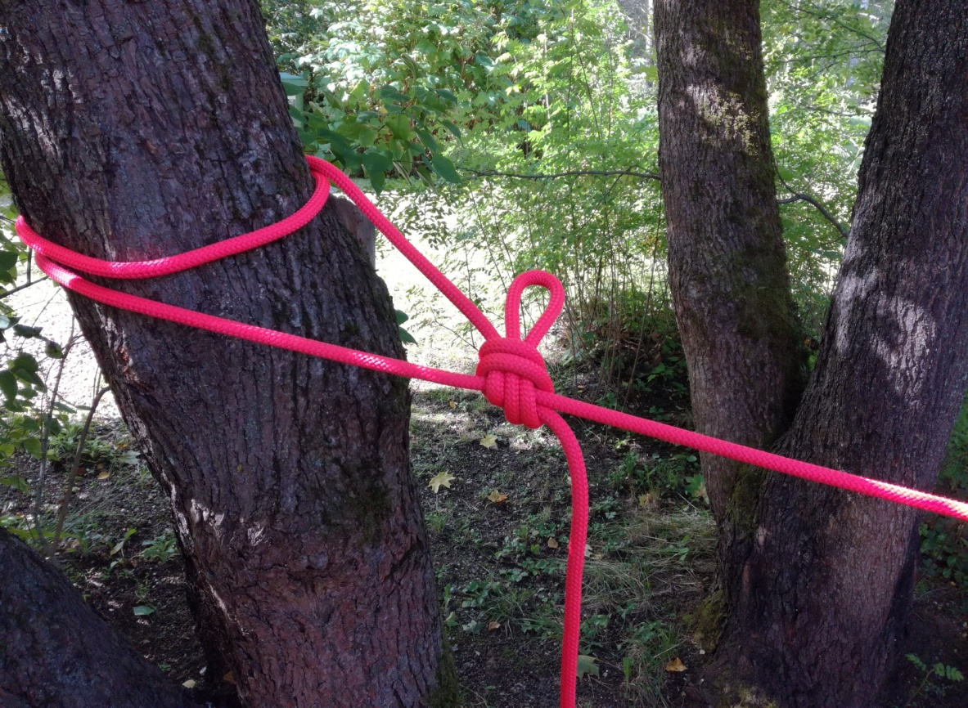
Doble vuelta + dos medios nudos
Un enganche estático que puede desunirse bajo carga.
Fácil de identificar
Los dos medios enganches se combinan para hacer un enganche de clavo.
Cuando está atado a la manga, puede ser una alternativa a un no nudo.
Notes:
1,Knots are created when a rope is tied onto its self eg Fig8 Bite, Fig 8 rethread, Alpine butterfly
2, Hitches are created a rope is tied around something eg Clove hitch, Italian hitch, Round turn & Two half hitches
3, Bends are created when 2 ropes are joined together. Eg Overhand, Double fishermans, Figure 8

Slide 10
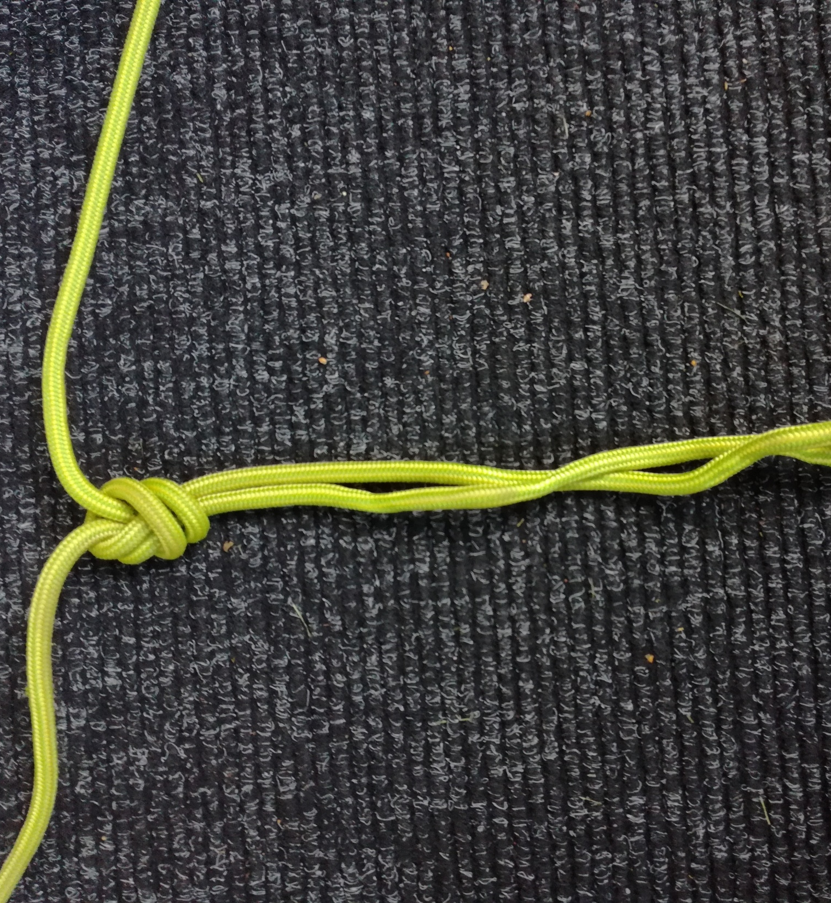
Cola de vaca (dos cuerdas
Se usa para atar dos cuerdas de igual grosor en aguas bravas.
Permite que un carabinero HMS pase el nudo con facilidad.
Deje las colas con 2 puños de ancho para no permitir el deslizamiento.
Notes:
1,Knots are created when a rope is tied onto its self eg Fig8 Bite, Fig 8 rethread, Alpine butterfly
2, Hitches are created a rope is tied around something eg Clove hitch, Italian hitch, Round turn & Two half hitches
3, Bends are created when 2 ropes are joined together. Eg Overhand, Double fishermans, Figure 8

Slide 11
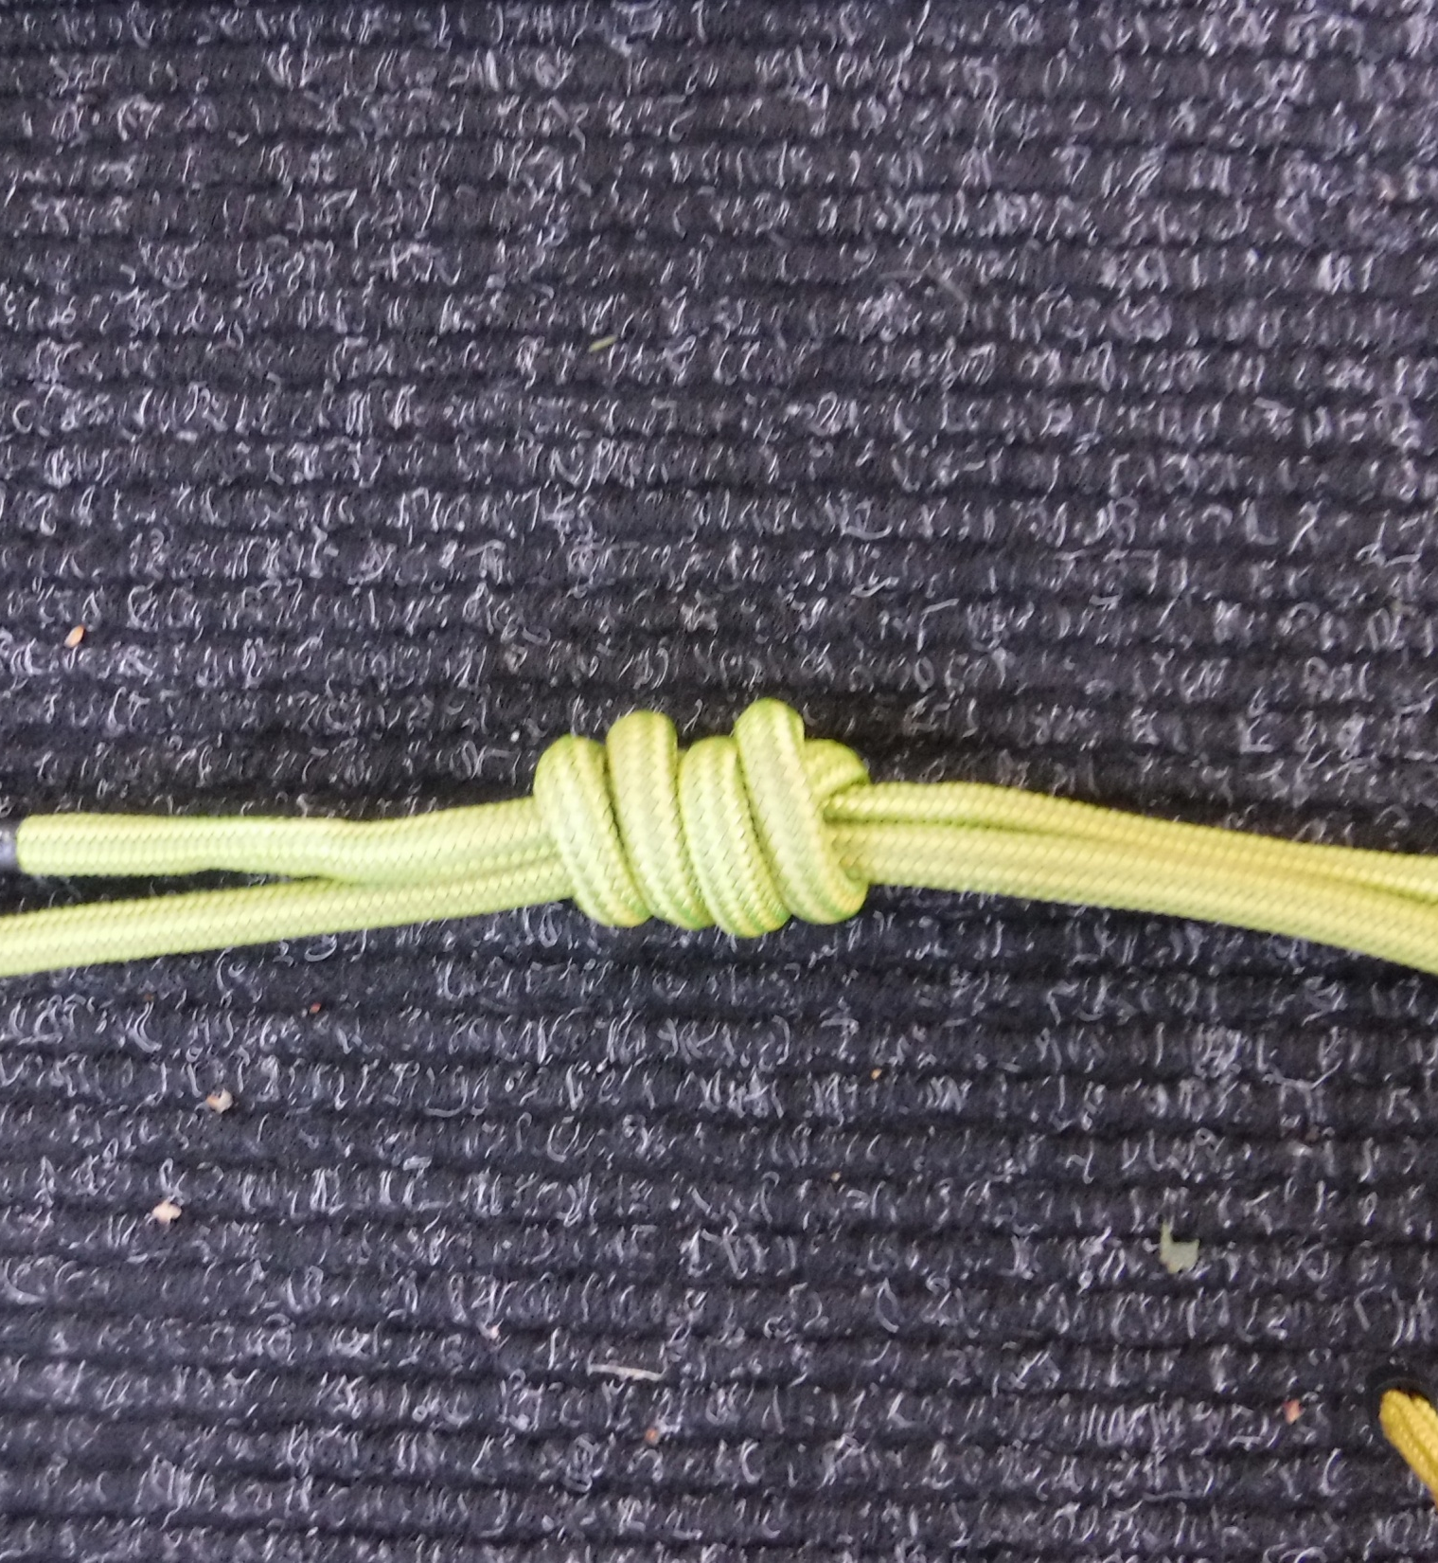
Pescador doble
Se usa para atar dos cuerdas de igual grosor normalmente para crear un bucle prusik. Una vez que el doble pescador se pliega y se tensa, es casi imposible desatarlo.
Fácil de verificar e identificar
Notes:
1,Knots are created when a rope is tied onto its self eg Fig8 Bite, Fig 8 rethread, Alpine butterfly
2, Hitches are created a rope is tied around something eg Clove hitch, Italian hitch, Round turn & Two half hitches
3, Bends are created when 2 ropes are joined together. Eg Overhand, Double fishermans, Figure 8

